Slide 1





SPOTIFY MUSIC RECOMMENDATION SYSTEM
Name: THIRUPATHI R Guide: P.Raja,Master Trainer
NM-ID: au923821114034
E-Mail ID:kdthiru520@gmail.com
Disclaimer: The content is curated for educational purposes only.
Notes:
Slides: Prepare a short slide deck (10-12 slides) summarizing the project objectives, methodology, and key results.

Slide 2
OUTLINE
Abstract of the Project
Problem Statement
Proposed Solution
System Architecture
Embedded Video of Project
Conclusion
Future Scope

Slide 3
Abstract
The Spotify Music Recommendation System aims to enhance music discovery by using machine learning to analyze and recommend songs based on user preferences. By employing the Spotify songs dataset, available through Kaggle, this system leverages K-Means clustering and cosine similarity to group songs by key audio features such as tempo, danceability, energy, loudness, and other musical characteristics. Once these clusters are created, songs within a cluster are assumed to share similarities in sound and style, making them suitable candidates for recommendations.

Slide 4
Problem Statement
The vast amount of music on platforms like Spotify presents a challenge for users in discovering music that aligns with their preferences. This project addresses this by developing a recommendation system that groups songs by similarity, allowing for recommendations that match the user's tastes.

Slide 5
Proposed Solution
To develop a more advanced spotify music recommendation system,a solution can focus on integrating various AI-driven and user-centered enhancements.
Here’s a proposed solution with a phased approach:
Data collection and preprocessing enhancements
Improved presonalization algorithms
User experience enhancements
Real-time feedback and Dynamic adjustment

Slide 6
System Architecture
The system architecture for an advanced Spotify music recommendation system would consist of several layers and components designed to gather,process,and analyze user data efficiently,delivering personalized and context-aware music recommendations.
Here’s a high-level architecture overview :
Data collection Layer
Data Storage Layer
Data Processing Layer

Slide 7
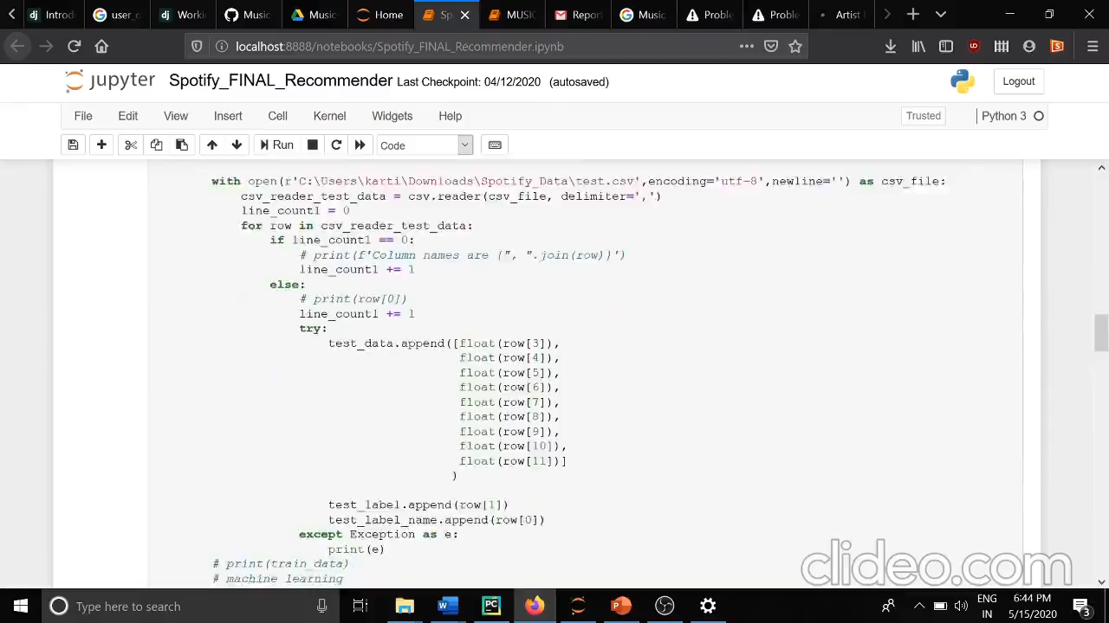
Video of Project Demo

Slide 8
Conclusion
The Spotify Music Recommendation System successfully demonstrates how clustering and similarity-based analysis can be applied to generate music recommendations that align with user preferences. By leveraging unsupervised learning (K-Means clustering) and cosine similarity, the system provides an efficient way to group and recommend songs based on key audio features, resulting in a recommendation system that enhances music discovery.

Slide 9
Future Scope
The future of spotify’s music recommendation system is quite promising as advancements in AI and machine learning continue to refine how music is recommended.Here are some potential areas of developments.
Enhanced personalization
Context-aware recommendations
Social and collabrative filtering
Generative AI for new music discovery

Slide 10
Thank you!
Notes:
thank you very much for joining this PPT, keep learning.
10

